Slide 1
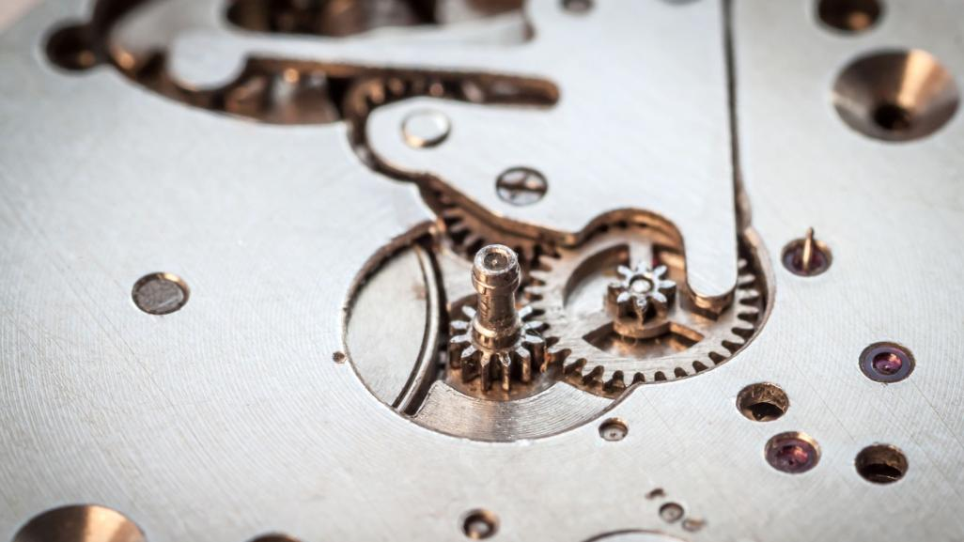
Dynamics of Machine
Project
Submitted to
Dr. Amiya Dash
Mr. .Tirath Kumar.
Submitted by
Gunda Venkata Sai Jai Harsha.
190169/190C205003.

Slide 2
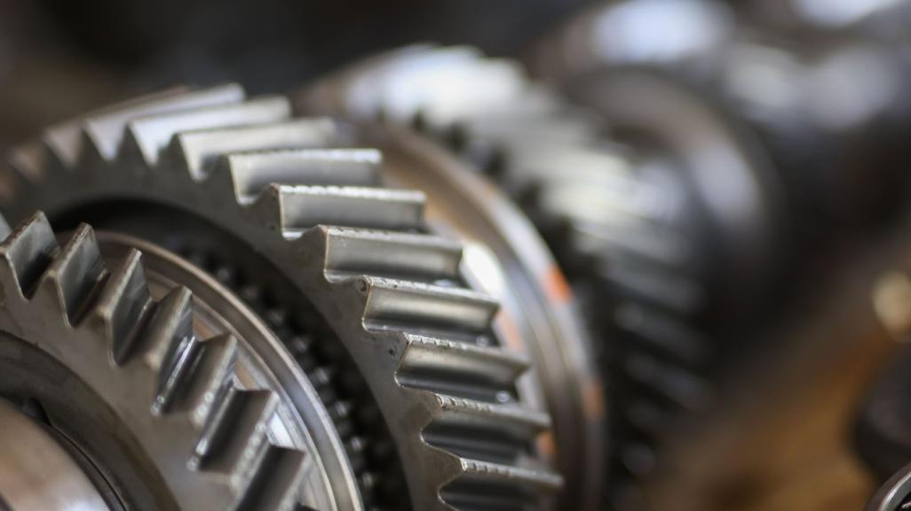
STIRILING ENGINE

Slide 3
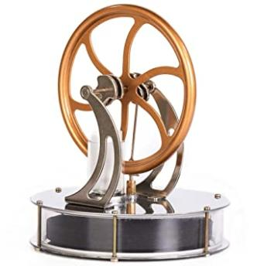
INTRODUCTION
A Stirling Engine is an extremely efficient device at extracting energy from heat differences (i.e., one side hot and one side cold) and it can be run from any fuel or energy source from the sun, to a candle, or from burning wood to the heat from your hand. Best of all, it is surprisingly simple to make a working model Stirling engine from readily accessible free or cheaply available parts and without expensive tools.
It is device that converts heat energy to mechanical power by alternately compressing and expanding a fixed quantity of working fluid at different temperatures.
Regeneration as alternative.

Slide 4
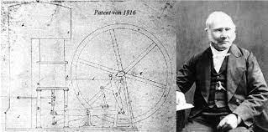
HISTORY
The Stirling Engine is one of the hot air engines. It was invented by Robert Stirling (1790-1878) and his brother James. His father was interesting in engine, and he inherited it. He became a minister of the church at Scotland in 1816.
At this period, he found the steam engines are dangerous for the workers. He decided to improve the design of an existing air engine. He hope it wound be safer alternative.

Slide 5
LITERATURE
https://auto.howstuffworks.com/stirling-engine.htm
UNIVERSITY OF GÄVLE/STIRLING ENGINE.
https://en.wikipedia.org › wiki › Stirling_engine
https://www.explainthatstuff.com › how-stirling-engines...

Slide 6
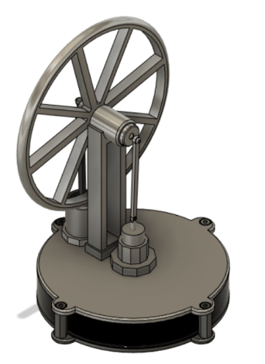
3D MODEL
STIRILING ENGINE

Slide 7
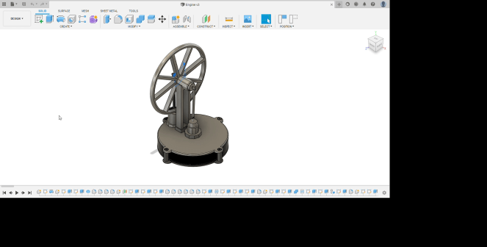
ANIMATION

Slide 8
PARTS
Tube
Plates
Fly wheel
Fly wheel Tower
Power Piston
Displacer
Connecting Rod

Slide 9

2D SKETCHES

Slide 10
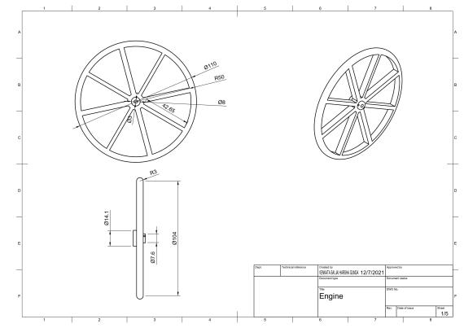
FLY WHEEL

Slide 11
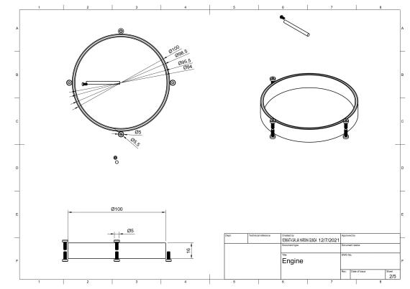
BIG TUBE BASE

Slide 12
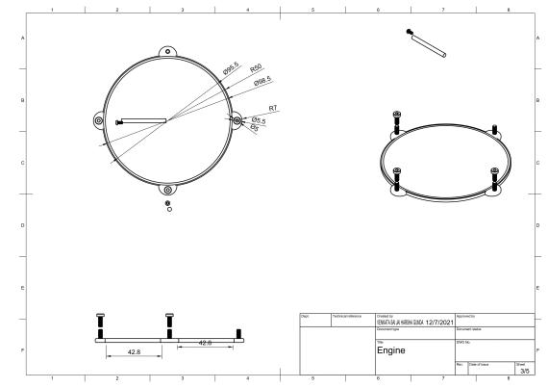
PLATE

Slide 13
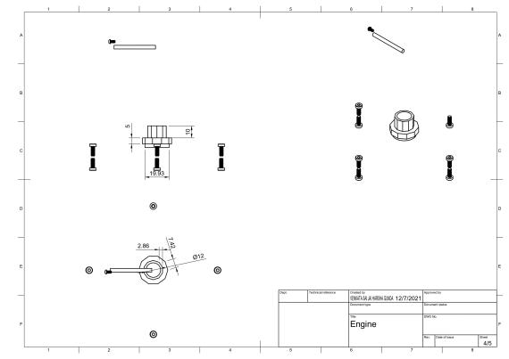
DISPLACER PISTON

Slide 14
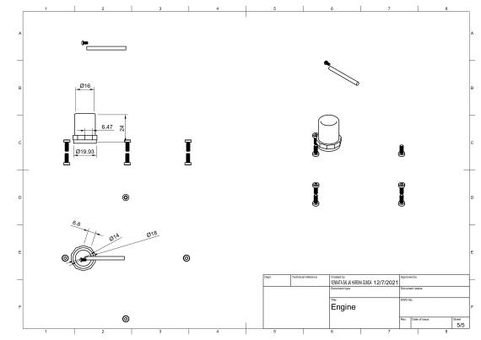
POWER PISTON

Slide 15
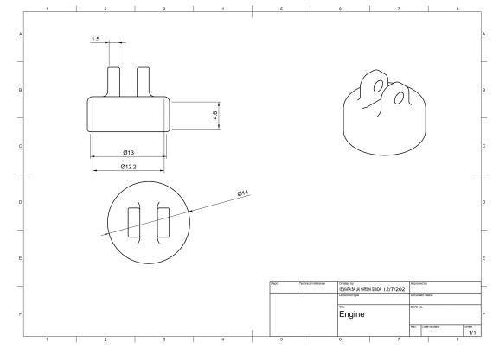
POWER PISTON DOWN

Slide 16
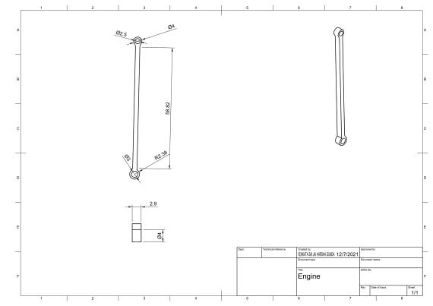
CONNECTING ROD

Slide 17
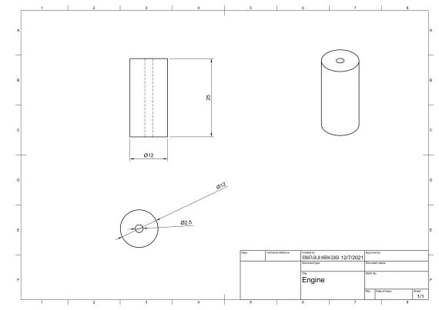
DISPLACER

Slide 18
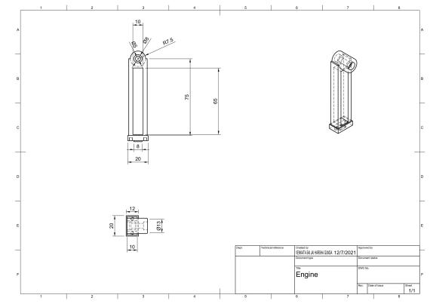
FLYWHEEL TOWER

Slide 19
BILL OF MATERIAL
s.no | Part name | Material | volume mm^3 | Density | Mass g | Rate /g | Quanity | Total
1 | Big Tube | Acrylic | 14088.749 | 0.001 | 16.766 | 0.2 | 1 | 3.3532
2 | plate | Copper | 23891.15 | 0.009 | 213.587 | 0.45 | 1 | 96.11415
3 | Plate 2 | copper | 22380.727 | 0.009 | 199.92 | 0.45 | 1 | 89.964
4 | Displacer piston | Brass | 2896.79 | 0.008 | 24.594 | 0.3 | 1 | 7.3782
5 | power piston | steel | 3168.998 | 0.008 | 11.182 | 0.19 | 1 | 2.12458
6 | Fly wheel tower | Aluminium | 10221.025 | 0.003 | 27.597 | 0.25 | 1 | 6.89925
7 | Flywheel | Steel | 17981.97 | 0.008 | 152.664 | 0.19 | 1 | 29.00616
8 | Displacer bushing | Steel | 2704.7 | 0.008 | 21.232 | 0.19 | 1 | 4.03408
9 | Bearing 1 | steel | 162.947 | 0.008 | 1.279 | 0.19 | 2 | 0.48602
10 | power piston | steel | 1125.211 | 0.008 | 6.652 | 0.19 | 1 | 1.26388
11 | Lower rubber | steel | 538.51 | 0.008 | 4.227 | 0.19 | 2 | 1.60626
12 | spacers | steel | 1627.48 | 0.008 | 12.776 | 0.19 | 4 | 9.70976
13 | Connecting rod | laminate | 246.083 | 0.001 | 0.34 | 0.11 | 2 | 0.0748
 |  |  |  |  |  |  | Total cost | 252.0143

Slide 20
APPLICATIONS
CARS A car can change the power quickly.
Water pump stations
Combined heat and power plant
Solar power generation
Stirling cryocoolers
Heat pump
Marine engines
Nuclear power
Aircraft engines
Micro CHP

Slide 21
ADVANTAGES
Various heat sources (solar, geothermal, nuclear energy, waste heat, biological)
Heat is external and the burning of a fuel-air mixture can be more accurately controlled.
Operates at relatively low pressure and thus are much safer than typical steam turbines
Less manpower needed to operate any type of commercial Stirling engine.

Slide 22
DISADVANTAGES
The price : its cost is probably the most important problem, it is not yet competitive with other means well established.
The ignorance of this type of engine by the general public. Only a few fans know it exists. It is therefore necessary to promote it.
The variety of models prevents standardization and, consequently, lower prices.
Heat transfers with a gas are delicate and often require bulky apparatus.

Slide 23

Innovativeness & Usefulness:
The Stirling engine is an efficient engine that requires outside heat to operate. Because of this, the effect of pollution is eliminated.
Stirling engines can operate on different types of fuel, including natural gas, propane, gasoline, diesel, bio-fuels, and sunlight.
One of the best features is the extra-quiet operation of the machine, along with the capability of burning slowly.
Many engines can be used as a heat pump when driven by a motor or another Stirling engine, which allows them to be used for space conditioning, refrigeration, and cryo-cooling.

Slide 24
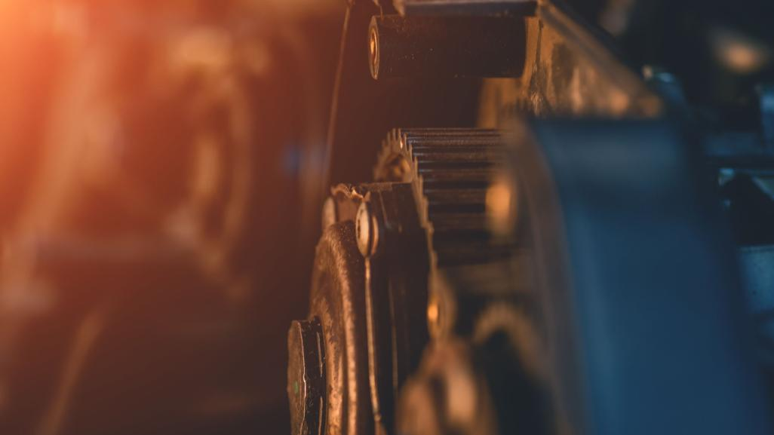
CONCLUSION
The Stirling engine is noted for its high efficiency compared to steam engines, quiet operation, and the ease with which it can use almost any heat source.
Stirling Engines are very flexible. There are a lot of different types of engines. They can be very small and run with only a small temperature difference, they are very quiet, for example to use them in submarines or they can be used as a CHP plant.
Another good point is that they can be constructed in a way that they produce no emissions. That means, in combination with solar or geothermal heat, they can be used as a renewable energy source to produce electricity.

Slide 25
THANK YOU

